Slide 1
LIFE EXPECTANCY (WHO) WITH SEVERAL ML TECHNIQUES

Slide 2






Roles and Responsibilities:
SaiSunilKumar Ponduri - 700741913
Developed and tested models to predict life expectancy using the selected features. Evaluated the models and communicated the results to the team. Reported any issues to the team and works with them to resolve them.
Kadire Sanjay Kumar Reddy - 700741058
Extracted, cleaned and preprocessed the data for analysis. Optimized the model for performance and scalability. Used statistical techniques to identify important features and trends in the data.
Jayanth Sri Sai Dulla - 700734068
Implemented machine learning algorithms using the selected features and models developed by the data analysis. Creates a user-friendly interface to access and use the models. Conducts experiments to evaluate the effectiveness of the models.
Jagadeeswar Chimata - 700731649
Ensured that the models developed is accurate and reliable. Conducted testing and validation to identify any errors or issues with the models. Developed and maintained documentation for the models, including user manuals and technical specifications.

Slide 3
MOTIVATION
The primary motivation behind this project is to predict Life expectancy of the people using various machine leaning techniques.
It is important to understand the life expectancy to capture the child mortality and assessment of public health.
we are conducting an experimental analysis on the country level life expectancy data.
In our experimental analysis we have considered the parameters like Hepatitis B , Polio etc.., This study will focus mainly on immunization.

Slide 4
OBJECTIVES
The objective of our project is to understand which features/attributes are statistically significant in running different models with various combinations of models.
We apply multiple regression models to calculate the linear relationship between the dependent and independent variables.

Slide 5
RELATED WORK
The study analyzed 18 factors that may impact life expectancy, including GDP, illness, and education levels.
Three multiple linear regression models were developed to predict life expectancy based on income, health, and education levels.
The study found that these three factors significantly influenced life expectancy.
The main objectives of life expectancy research are to develop forecasting models and parametric life expectancy models using mortality patterns and sample populations.
These models incorporate empirical research on factors such as weight, respiration rate, heart rate, and blood pressure to predict life expectancy.
Education, healthcare, and technology were found to have a significant and positive impact on life expectancy, and this information can be useful for governments and insurance companies in developing nations.

Slide 6
The study aims to evaluate the performance of two feature selection techniques when used with data from thoracic surgery and seven machine learning techniques.
Feature selection is a critical pre-processing stage in identifying factors that impact post-operative life expectancy for lung cancer patients undergoing major thoracic surgeries.
The study focuses on the patient's underlying health conditions as a potential predictor of surgical-related mortality and evaluates the effectiveness of seven machine learning techniques, including Naive Bayes, Linear SVM, MLP, RBF Network, SMO, KNN, and CART.
Predicting life expectancy is challenging due to the vast number of variables that need to be considered.
Measuring, classifying, characterizing, and predicting using generic statistical values is practically difficult and can lead to inaccuracies.
The development of smartphone and wearable device applications, along with data science technologies, has made health-related data more accessible, which can aid in predicting life expectancy.

Slide 7
PROBLEM STATEMENT
The global life expectancy trend has been increasing until 2019, with an overall life expectancy of 66.8 years between 2000-2019.
While there has been an 8% increase in life expectancy from 2000 to 2019, some countries' healthy life expectancy (HLE) is not showing an increasing trend.
GHO, under WHO, tracks the records of 193 countries, and understanding the factors affecting life expectancy is a challenging task due to the varying factors for different countries.
Selecting the best features from the data is a cumbersome task when it comes to understanding the factors affecting life expectancy.

Slide 8
PROPOSED SOLUTION
In this project we are collecting a dataset that is publicly available in kaggle the original source of the dataset.
The features include Hepatitis, economic factors, social factors in total 22 features to predict the life expectancy of the country.
In this project we are proposing several machine learning techniques and feature selection methods to predict the life expectancy number.
For this experiment we are proposing Linear Regressor, Random Forest regressor and XGBoost Regressor algorithms

Slide 9
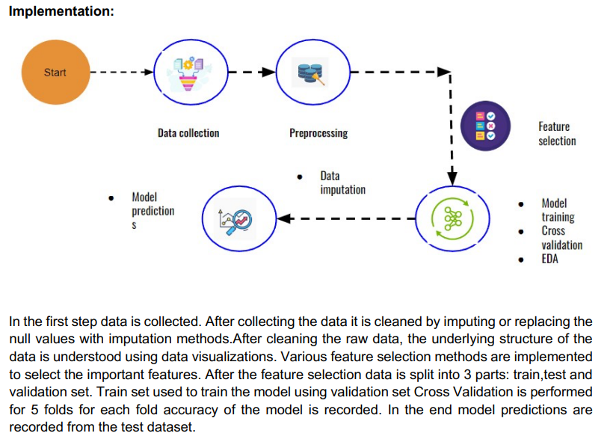

Slide 10
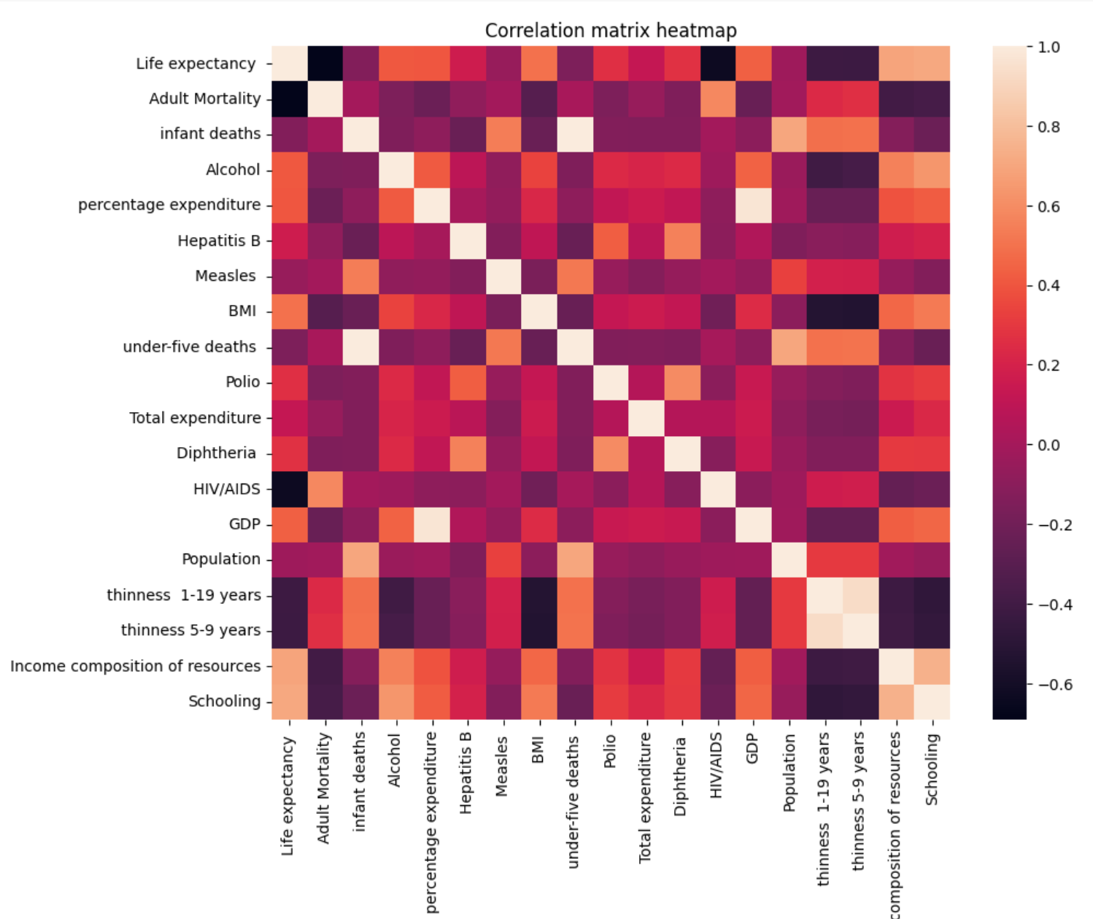
RESULTS / SIMULATIONS

Slide 11
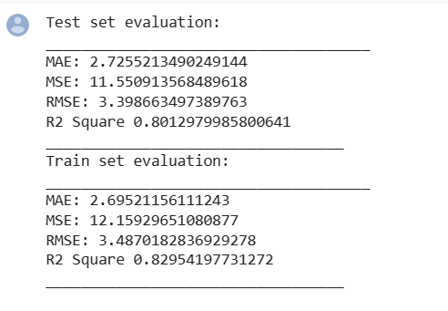
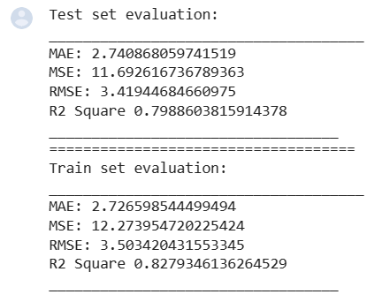
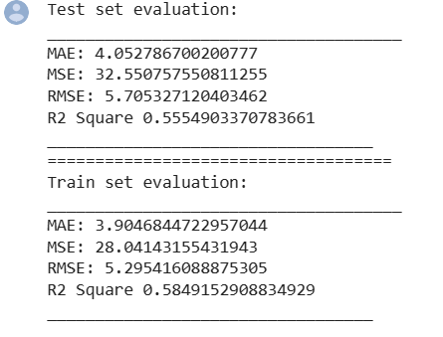
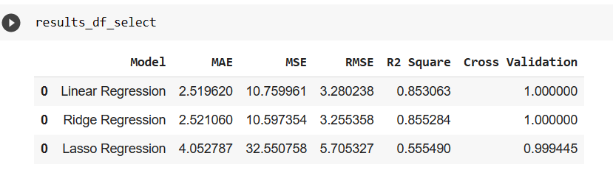
RESULTS / SIMULATIONS
Linear regression
Ridge regression
Lasso regression
Summarization

Slide 12
REFERENCES
[1].M. A. Rubi, H. I. Bijoy and A. K. Bitto, "Life Expectancy Prediction Based on GDP and Population Size of Bangladesh using Multiple Linear Regression and ANN Model," 2021 12th International Conference on Computing Communication and Networking Technologies (ICCCNT), Kharagpur, India, 2021, pp. 1-6, doi: 10.1109/ICCCNT51525.2021.9579594.
[2].S. Panda, B. Purkayastha, D. Das, M. Chakraborty and S. K. Biswas, "Health Insurance Cost Prediction Using Regression Models," 2022 International Conference on Machine Learning, Big Data, Cloud and Parallel Computing (COM-IT-CON), Faridabad, India, 2022, pp. 168-173, doi: 10.1109/COM-IT-CON54601.2022.9850653.
[3]. K. Gupta, R. Rani, A. Sharma, P. Bansal, A. Dev and R. Gandhi, "Predicting Gender Development Index using Machine Learning," 2023 13th International Conference on Cloud Computing, Data Science & Engineering (Confluence), Noida, India, 2023, pp. 530-535, doi: 10.1109/Confluence56041.2023.10048850.

